Slide 1
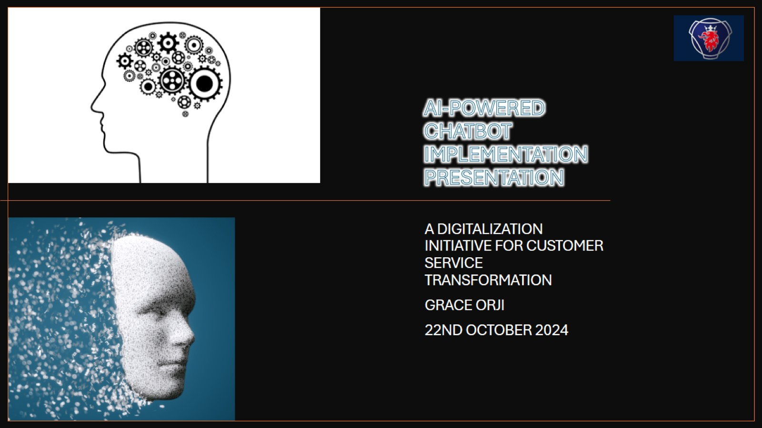
AI-POWERED CHATBOT IMPLEMENTATION PRESENTATION

Slide 2

WHAT WAS THE USE CASE
Notes:
The problem we were addressing was the high volume of repetitive queries overwhelming the customer service team. This led to longer response times and decreased efficiency. To solve this, we implemented an AI-powered chatbot designed to automate these repetitive tasks. By doing so, we freed up human agents to focus on more complex, value-adding inquiries, ensuring a better overall customer service experience. This initiative serves as our use case for transforming customer service operations.

Slide 3
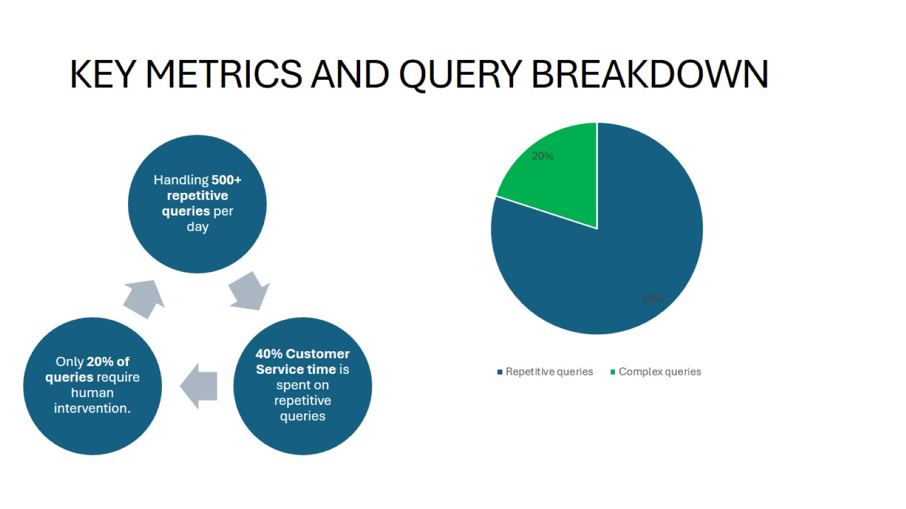
KEY METRICS AND QUERY BREAKDOWN

Slide 4
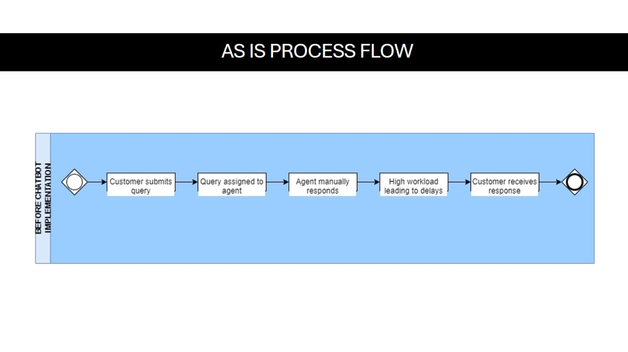
AS IS PROCESS FLOW

Slide 5
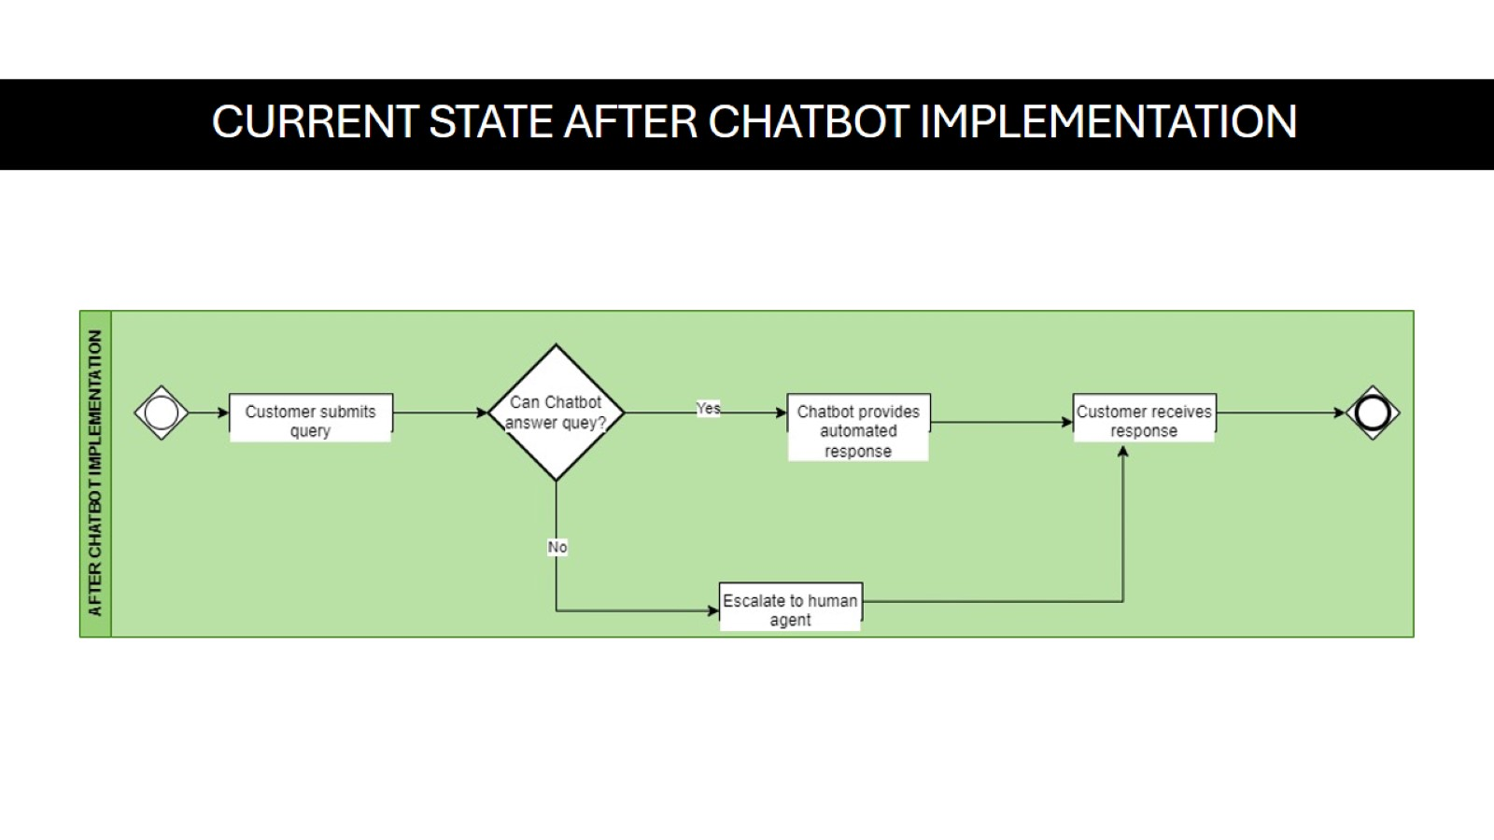
CURRENT STATE AFTER CHATBOT IMPLEMENTATION

Slide 6
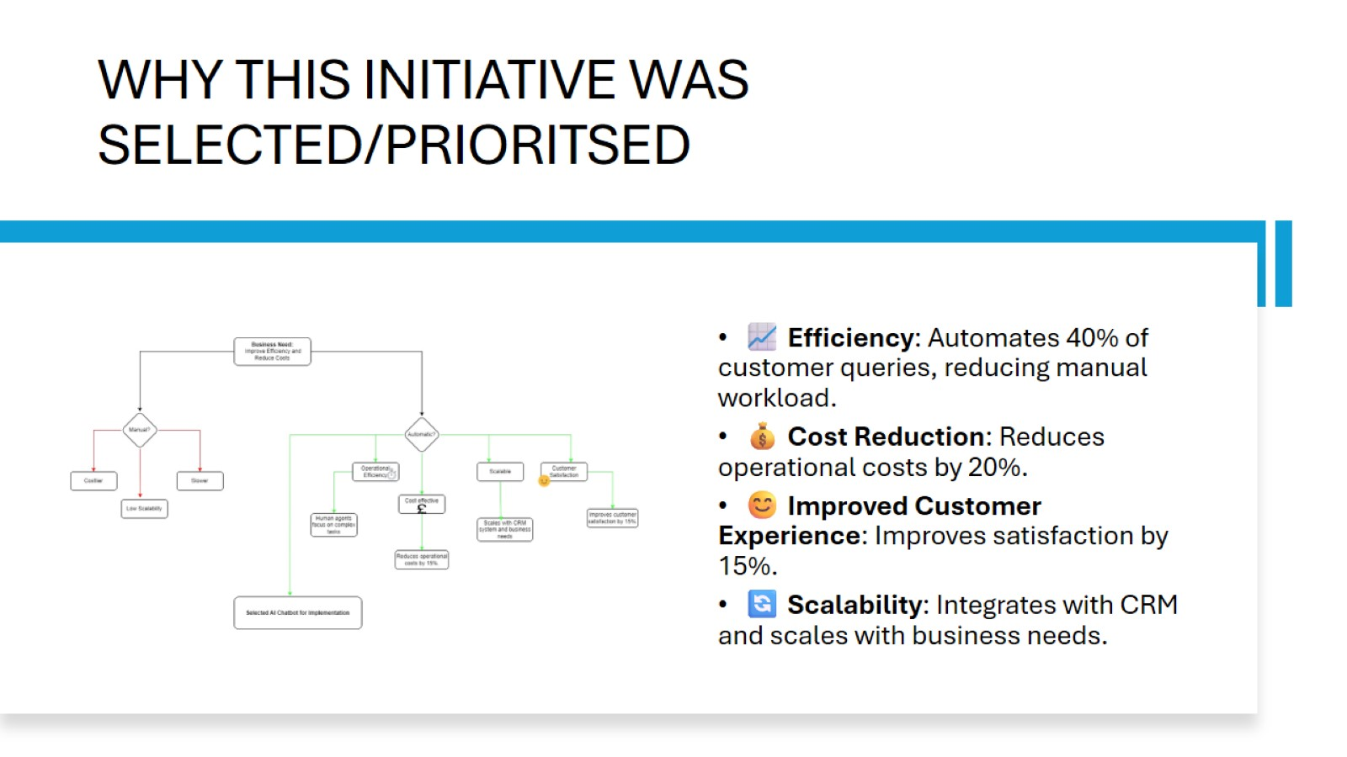
WHY THIS INITIATIVE WAS SELECTED/PRIORITSED
Notes:
We chose this initiative over others primarily because of the need to improve efficiency, reduce operational costs, and enhance customer experiences. The AI-powered chatbot stood out due to its ability to handle repetitive tasks at scale, offering significant time and cost savings. Additionally, it seamlessly integrated with our existing CRM system, further streamlining operations. This chatbot implementation was a strategic move aligned with our broader digital transformation goals, which prioritized automation and customer satisfaction.

Slide 7
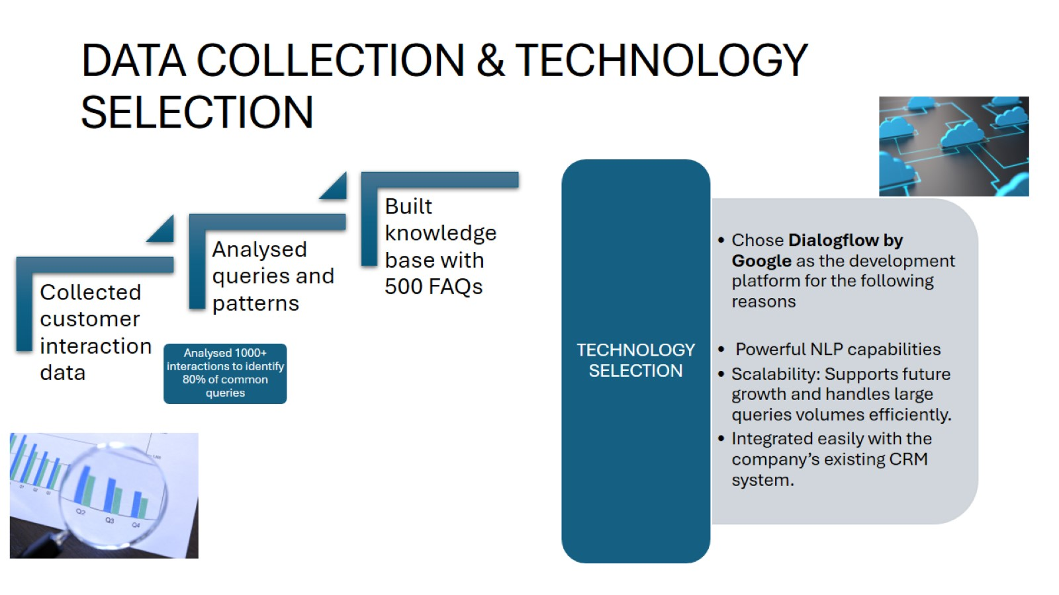
DATA COLLECTION & TECHNOLOGY SELECTION
Notes:
We started by analyzing historical customer interaction data to identify the most common queries. This data formed the basis of our chatbot's knowledge base. For technology, we selected Dialogflow by Google due to its robust NLP capabilities, easy integration with our CRM, and scalability. Dialogflow allowed for a seamless implementation, providing a smooth user experience, which was crucial for ensuring customer satisfaction right from the start.

Slide 8
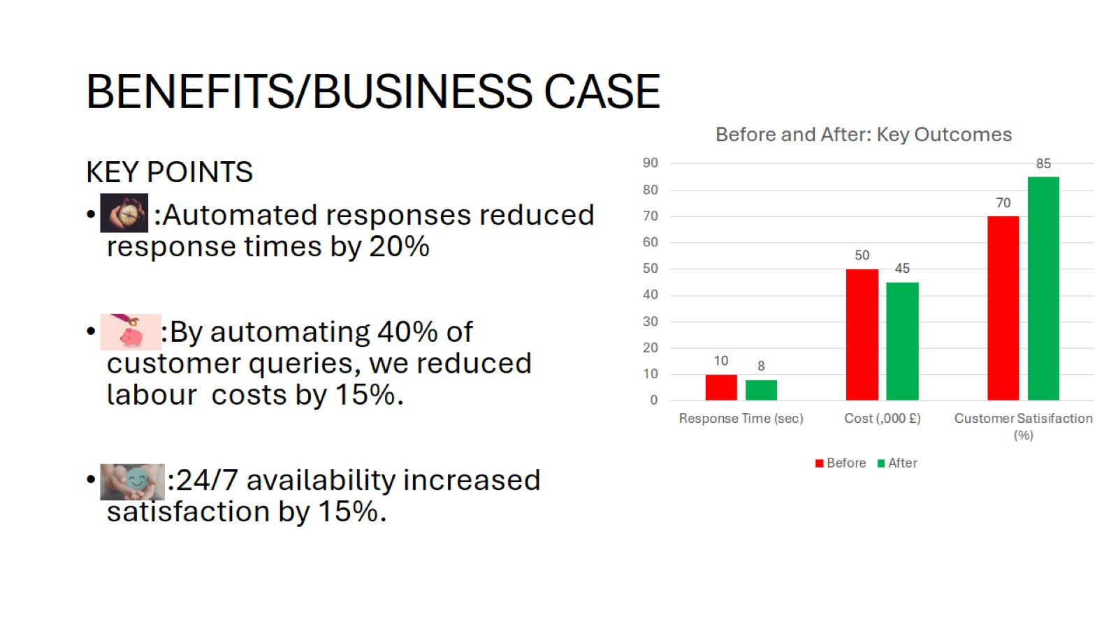
BENEFITS/BUSINESS CASE
Notes:
The business case for the chatbot focused on three key benefits: efficiency, cost savings, and customer satisfaction. First, automating routine queries improved response times by 20%, as the chatbot handled these tasks faster and with fewer errors. Second, we reduced operational costs by 15%, as automation freed up valuable resources within the customer service team. Finally, the chatbot's 24/7 availability improved customer satisfaction by 15%, ensuring that customers received timely support at any time of day.

Slide 9
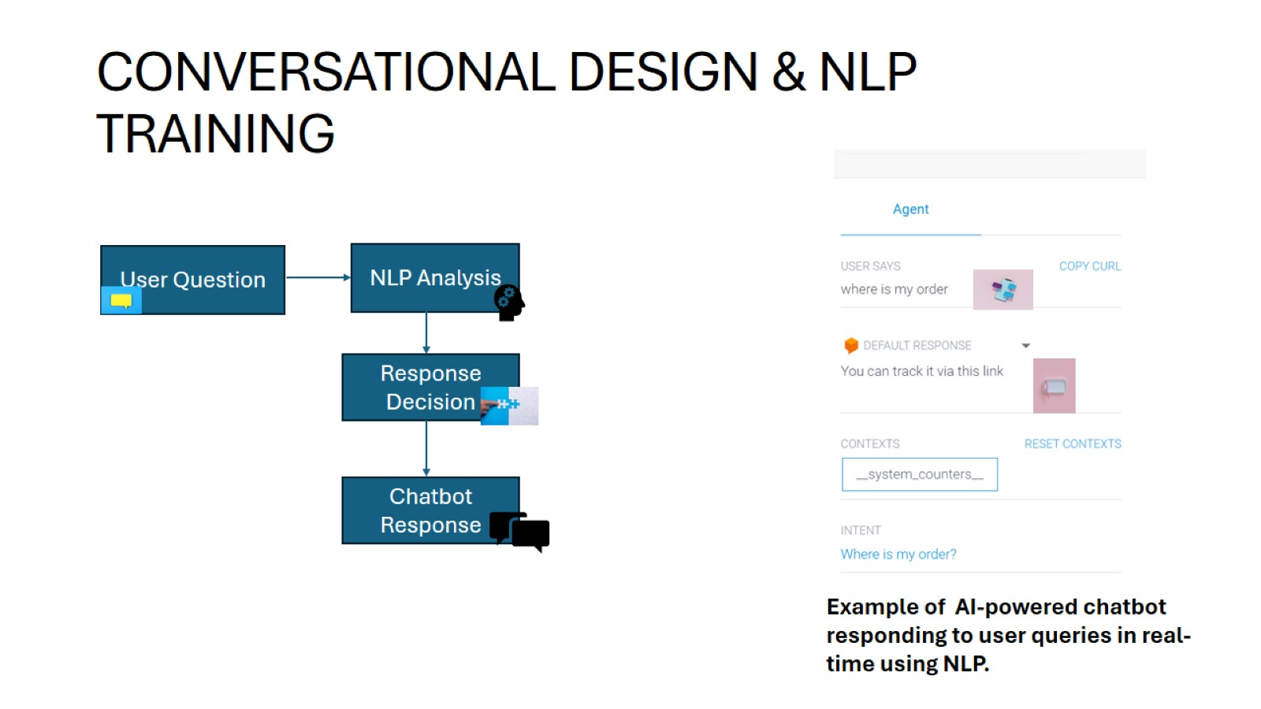
CONVERSATIONAL DESIGN & NLP TRAINING
Notes:
In designing the chatbot, we mapped out the possible user journeys to ensure smooth and intuitive conversation flows. The goal was to create a seamless user experience that guided customers through their queries effortlessly. Using Natural Language Processing (NLP), we trained the chatbot to recognize different intents and understand various ways customers phrased their questions. Continuous training was crucial, as it allowed the chatbot to improve its contextual understanding and provide more accurate responses over time.

Slide 10
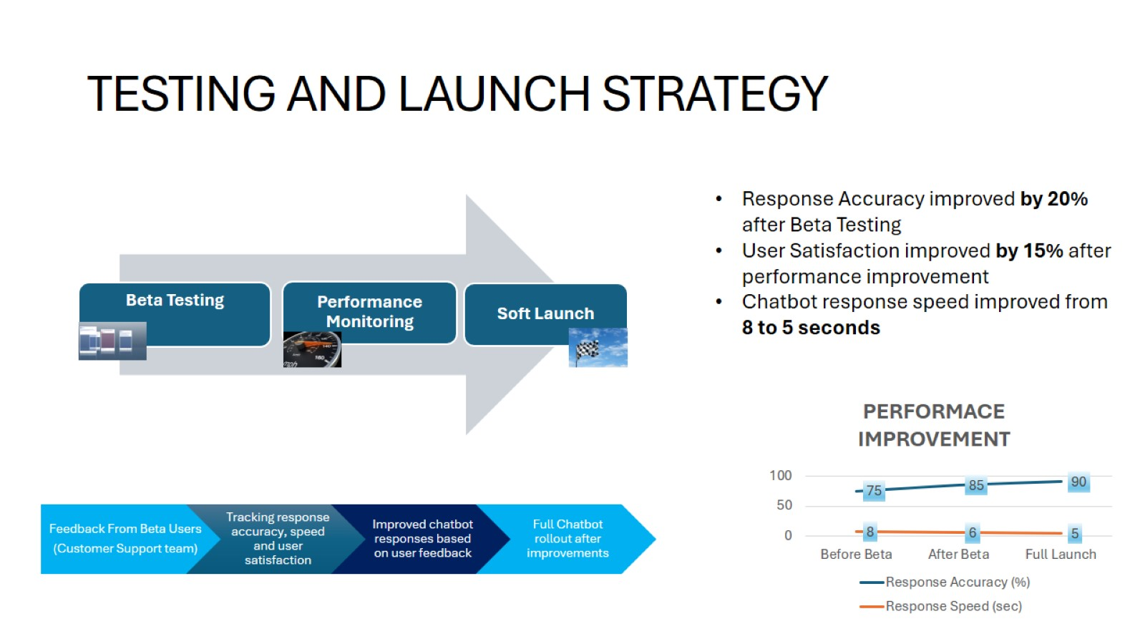
TESTING AND LAUNCH STRATEGY
Notes:
We launched the chatbot in a beta phase with a select group of users. During this phase, we gathered feedback to refine the chatbot’s responses and optimize its performance. We also set up performance monitoring systems to track key metrics, including response accuracy, speed, and user satisfaction. After refining these aspects, we conducted a soft launch, introducing the chatbot to a limited audience to test its scalability and gather additional feedback before the full rollout.

Slide 11
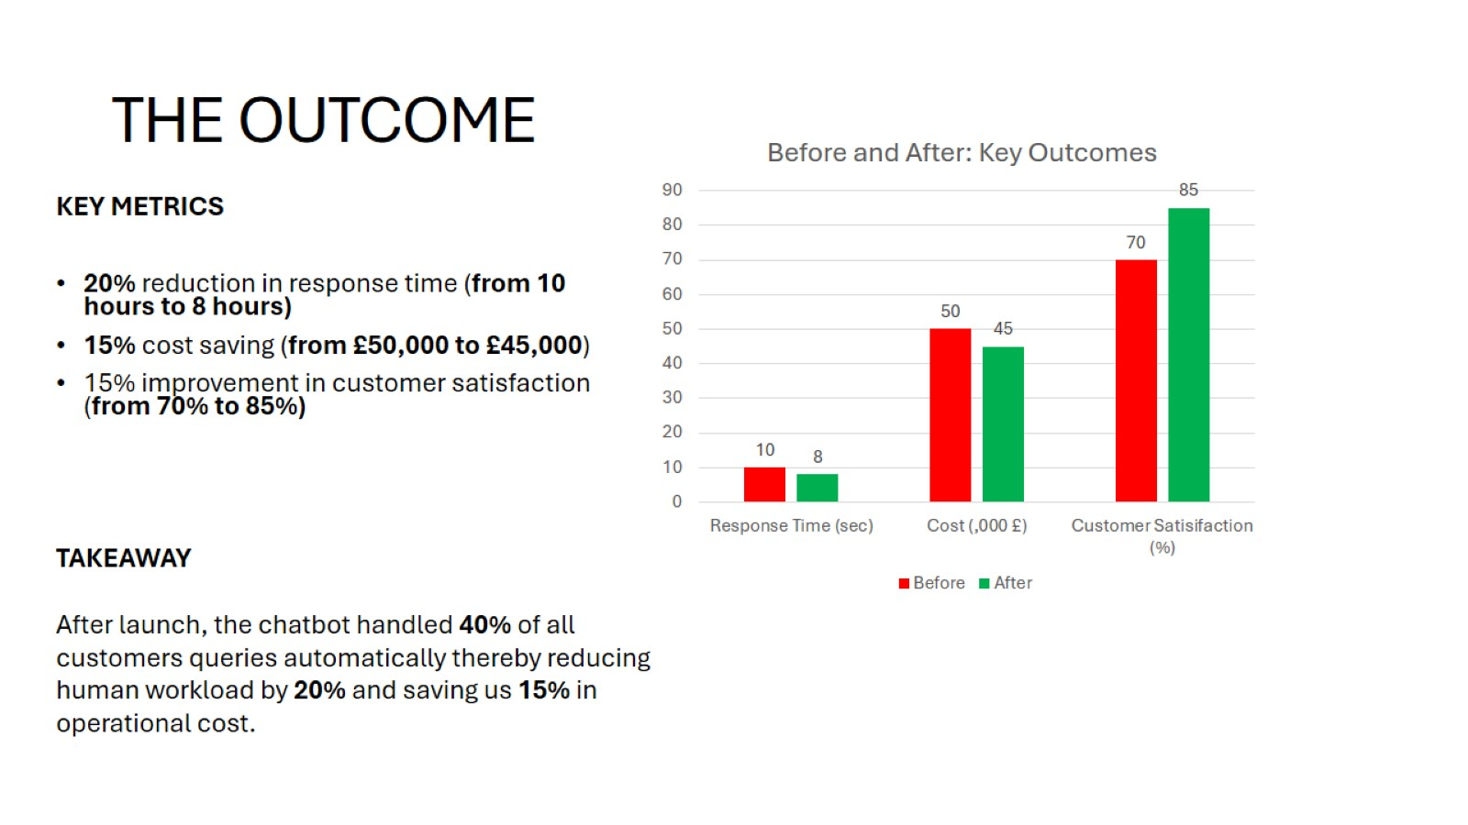
THE OUTCOME
Notes:
The outcomes of the project were clear and measurable. We reduced average response times by 20% and saved 15% on operational costs by automating 40% of customer queries. In addition, customer satisfaction increased by 15%, thanks to the chatbot's efficiency and 24/7 availability. These metrics demonstrate how the chatbot not only improved operational efficiency but also had a significant impact on our overall customer service performance.”

Slide 12


CONCLUSION & Q&A
CONCLUSION
Q
&
A
PRESENTATION BY:
Grace Orji
OCT/2024
Thank you for your attention.
Please feel free to ask your questions …
Clear Goals
Effective Collaboration
Continous Iteration
Notes:
In conclusion, the success of this project was driven by clear communication, collaboration between teams, and continuous improvement. One of the key lessons we learned was the importance of regularly updating the chatbot’s knowledge base and training it on new queries to keep it effective. I’d be happy to discuss any specific aspects of this initiative further or answer any questions you may have.

